Slide 1
Common Problems With Data
Pravin Y Pawar
Largely adapted from Machine Learning Engineering
By Andriy Burkov

Slide 2
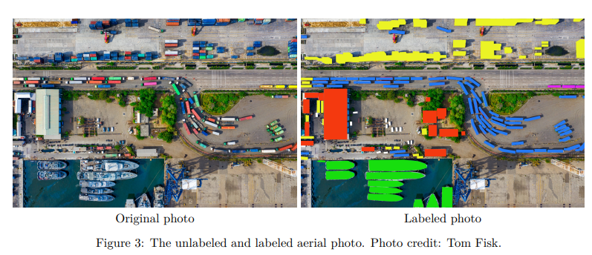
High Cost
Labeling
Getting unlabeled data can be expensive
however, labeling data is the most expensive work, especially if the work is done manually
also when it must be gathered specifically for your problem
must be assigned manually, and paying someone to do that work is expensive
Google has a clever technique outsourcing the labeling to random people with its free reCAPTCHA service
solves two problems:
reducing spam on the Web
providing cheap labeled data to Google
The goal of a good labeling process design
is to make the labeling as streamlined as possible

Slide 3
High Cost(2)
Tool-based labeling
Well-designed labeling tools
will minimize mouse use (including menus activated by mouse clicks), maximize hotkeys,
reduce costs by increasing the speed of data labeling.
Whenever possible, reduce decision-making to a yes/no answer
If the labeler clicks “Not Sure,” can save this example to analyze later or simply not use such examples for
training the model
Another trick allowing for accelerated labeling is noisy pre-labeling consisting of prelabeling the
example using the current best model
start by labeling a certain quantity of examples “from scratch” (that is, without using any support)
build the first model that works reasonably well, using this initial set of labeled examples
Next, use the current model and label each new example in place of the human labeler
Ask whether the automatically assigned label is correct
If the labeler clicks “Yes,” save this example as usual
If they click “No,” then ask to label this example manually

Slide 4
Bad Quality
Data quality is one of the major factors affecting the performance of the model
Data quality has two components:
raw data quality and labeling quality
Some common problems with raw data are
noise,
bias,
low predictive power,
outdated examples,
outliers,
leakage

Slide 5
Noise
Noise in data is a corruption of examples
Images can be blurry or incomplete
Text can lose formatting, which makes some words concatenated or split
Audio data can have noise in the background
Poll answers can be incomplete or have missing attributes, such as the responder’s age or gender
Noise is often a random process that corrupts each example independently of other examples in the
collection
If tidy data has missing attributes, data imputation techniques can help in guessing values for those attributes
Blurred images can be deblurred using specific image deblurring algorithms
Noise in audio data can be algorithmically suppressed
Noise is more a problem when the dataset is relatively small (thousands of examples or less),
because the presence of noise can lead to overfitting
the algorithm may learn to model the noise contained in the training data, which is undesirable
In the big data context, on the other hand, noise is typically “averaged out” over multiple examples

Slide 6
Bias
Bias in data is an inconsistency with the phenomenon that data represents
occur for a number of reasons (which are not mutually exclusive)
Types of Bias
Selection bias
Omitted variable bias
Sponsorship or funding bias
Sampling bias (also known as distribution shift)
Prejudice or stereotype bias
Systematic value distortion
Experimenter bias
Labeling bias

Slide 7
Low Predictive Power
Is an issue that's often not considered until one has spent fruitless energy trying to train a good model
Don’t know whether
the model underperform because it is not expressive enough?
the data not contain enough information from which to learn?
Suppose the goal is to predict whether a listener will like a new song on a music streaming service
data is the name of the artist, the song title, lyrics, and whether that song is in their playlist
model trained with this data will be far from perfect!
Artists who are not in the listener’s playlist are unlikely to receive a high score from the model
many users will only add some songs of a specific artist to their playlist
musical preferences are significantly influenced by the song arrangement, choice of instruments, sound
effects, tone of voice, and subtle changes in tonality, rhythm, and beat
These are properties of songs that cannot be found in lyrics, title, or the artist’s name; they have to be
extracted from the sound file

Slide 8
Outdated Examples
Once you build the model and deploy it in production, the model usually performs well for some time!
a certain model quality monitoring procedure is deployed in the production environment
Once an erratic behavior is detected, new training data is added to adjust the model
the model is then retrained and redeployed
Often, the cause of an error is explained by the finiteness of the training set.
In such cases, additional training examples will solidify the model
However, in many practical scenarios, the model starts to make errors because of concept drift.
Concept drift is a fundamental change in the statistical relationship between features and label
Imagine your model predicts whether a user will like certain content on a website
Over time, the preferences of some users may start to change, perhaps due to aging, or because a user
discovers something new
examples added to the training data in the past no longer reflect some user’s preferences and start hurting the
model performance rather than contributing to it - aka concept drift

Slide 9
Outliers
Outliers are examples that look dissimilar to the majority of examples from the dataset
up to the data analyst to define “dissimilar”
Typically, measured by some distance metric, such as Euclidean distance
Shallow algorithms are particularly sensitive to outliers
linear or logistic regression, and some ensemble methods, such as AdaBoost
Debatable
Whether to exclude outliers from the training data, or to use machine learning algorithms and models robust to outliers
Deleting examples from a dataset is not considered scientifically or methodologically sound, especially in small
datasets
In the big data context, outliers don’t typically have a significant influence on the model
From a practical standpoint, if excluding some training examples results in better performance of the model on the
holdout data, the exclusion may be justified
Which examples to consider for exclusion can be decided based on a certain similarity measure

Slide 10
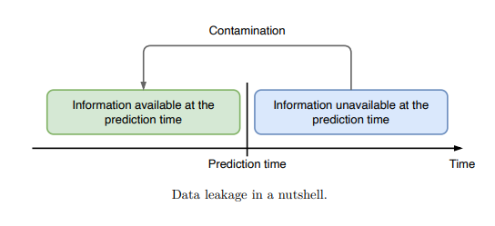
Data Leakage
Data leakage, also called target leakage,
a problem affecting several stages of the machine learning life cycle, from data collection to model evaluation
Data leakage in supervised learning is the unintentional introduction of information about the target that should not be made available
also called as “contamination”
Training on contaminated data leads to overly optimistic expectations about the model performance

Slide 11
Thank You!
In our next session:

